Slide 1
Spatial Pattern Measures
Scott Mitchell
GEOM4008

Slide 2
What is spatial pattern?
Composition
How much of each thing on the landscape?
Configuration
How are they arranged relative to each other?

Slide 3
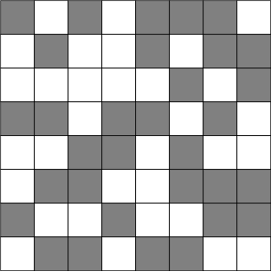
How surprised are we?
Is this random?
hypothesis testing

Slide 4
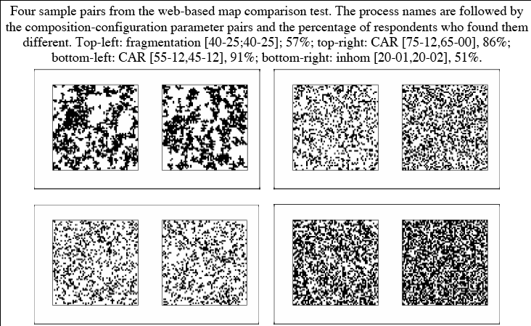
Can YOU see a difference?
Notes:
(SIG diff)

Slide 5
Point Pattern Analysis
events in space with coordinates
deviation from randomness: regular OR clumped
need model for “CSR”, and method to test against this model
Notes:
Simplest early attempts looked at various forms of ratio between variance and means in quadrats (see Dale paper)

Slide 6


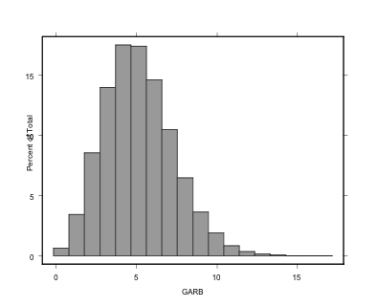
Is the point pattern Random?
CSR:(homogeneous) Poisson model
quadrat tests - e.g. index of dispersion, nearest neighbour, K function tests

Slide 7
Spatial Autocorrelation
Notes:
Go through at a conceptual level using these figures first… then proceed.

Slide 8
(… and we already talked about this)
Interpolation - recall governed by first law of geography, i.e. closer things more related than distant; discussed variograms as an assessment of how clumped things are (spatial autocorrelation) over what distances
other methods to assess SA:

Slide 9
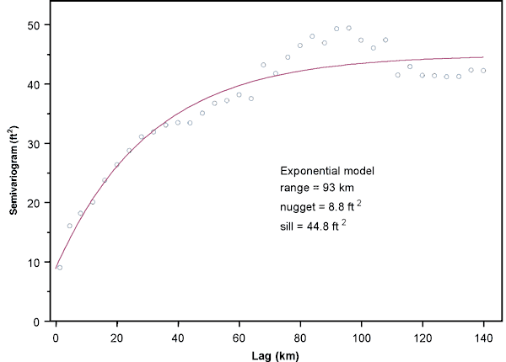
Recall: semi-variogram
Bohling and Wilson (2005)

Slide 10
Joins count (nominal data)
Number and type of joins between adjacent polygons
indicates clustering or spatial autocorrelation
If regions of interest are clustered more than random pattern (expected), freq(adjacent pixels with the same class (1)) should be > freq(adjacent pixels with <> classes (1,0)), ie., positive autocorrelation;
If frequency of counts of class 1-1 pixels < expected (random), negative autocorrelation.

Slide 11
Moran’s I: For interval or ratio data
similar to correlation of two variables
= covariance of values spatially separated (at any lag) divided by the variance;
+1 for positive autocorrelation;
-1 for negative autocorrelation
as with correlation, can test to see if value is significantly different from that due to chance

Slide 12
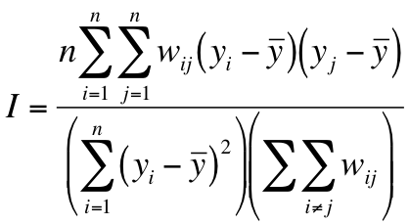
Moran’s I
W = proximity matrix,
Y = attributes
Notes:
Geary’s C is the other real common one - very similar except numerator compares yi yj, not mean
not strictly limited to range -1 to +1, but commonly a correction factor is used to force this range

Slide 13
BUT...
global statistic
recall geostatistical model of variance: at shorter distances, higher I - so I changes at different window sizes; results based on relative sizes of measurement area and the scale of spatial pattern

Slide 14
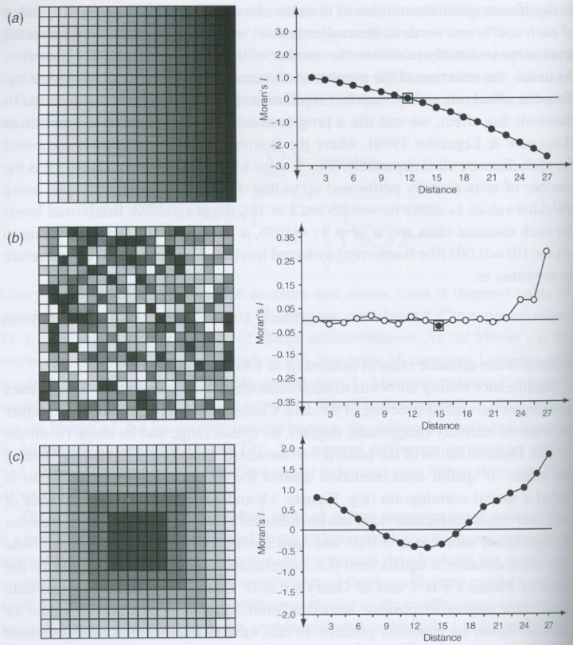
Notes:
all 20x20 grids with values increasing 0 to 10 white through black, with correlograms; solid circ = sig @ 0.05, squares refer to correction
a) gradient: see trend of sig +’ve vals @ short dists and negative @ large dists
b) random: vals oscillate around zero
c) one big patch: vals all sig and positive at short and large dists, but negative in between - spatial range about 7.5 - where sign changes
(next)

Slide 15
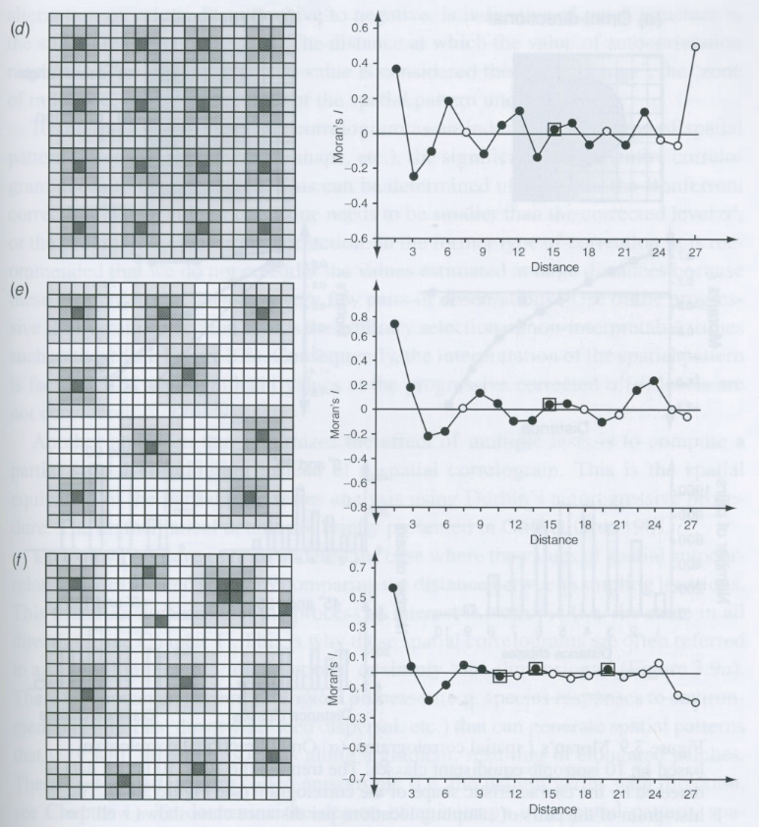
Notes:
d) 16 patches: first change of sign around 2.0, corr to range of the patches; then repeated oscillation in decreasing amplitude reflecting the repeated pattern
e) 9 patches, sign change around 3.0 units, repetitive pattern but now dist of repetition fluctuates
f) 12 patches - range about 2.5 units, repetitive pattern is not detected due to the size and dist varying

Slide 16
Local Index of Spatial Autocorrelation (LISAs)
large areas, global SA may not tell you about range or location of processes, or miss “local” pattern
classical: kernel estimation (moving windows)
excellent tools for EXPLORATORY work on spatial data (test stationarity, look for boundaries, hot spots, ...)
e.g. local versions of Moran, Geary, Getis statistics
Notes:
essentially, global SA statistics are the global average of these local versions
note that the book re-analyzes the maps in the previous 2 slides using 4 versions of LISAs and shows where significant PATCHES are (not easily reproducible)

Slide 17
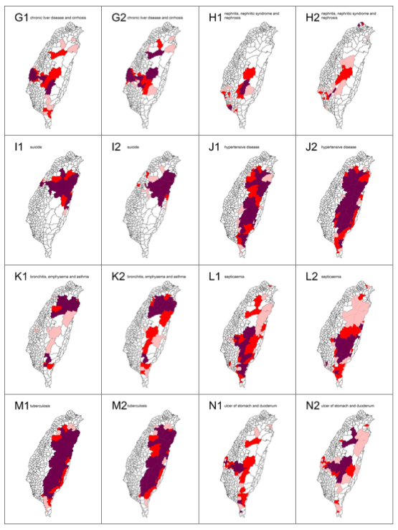
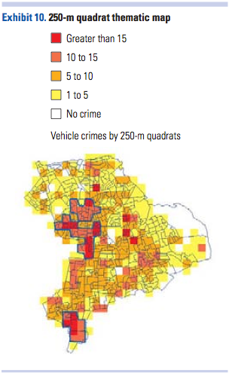
Hotspot mapping
Maps showing the spatial clusters of the 20 leading causes of death from top 7 to 14 in Taiwan in 2006: chronic liver disease and cirrhosis are designated by G; nephritis, nephritic syndrome and nephrosis, H; suicide, I; hypertensive disease, J; bronchitis, emphysema and asthma, K; septicaemia, L; tuberculosis, M; ulcer of stomach and duodenum, N. Gender is indicated by a number, where male is 1 and female is 2.
(Tsai et al. 2009)
Eck et al. (2005)

Slide 18
Measuring Pattern on maps: possibilities...
Moran and Geary for spatial autocorrelation
Semivariance
Frequency analysis - Fourier, wavelets
Fractal dimensions
Run lengths and join counts
landscape metrics / LPIs (LE heritage)

Slide 19
“Landscape metrics”
Wide variety of measures of pattern have come out of landscape ecology
Many are highly correlated
Usually don’t know full distributions for different config/composition -> lim stat test
Can be valuable descriptive tools
Also Shape indices (perimeter, area), connectivity / corridors
Notes:
Make it clear that these are NOT useless, but that the constraints on when valid/problematic to use them seem to be widely unrealized or ignored

Slide 20
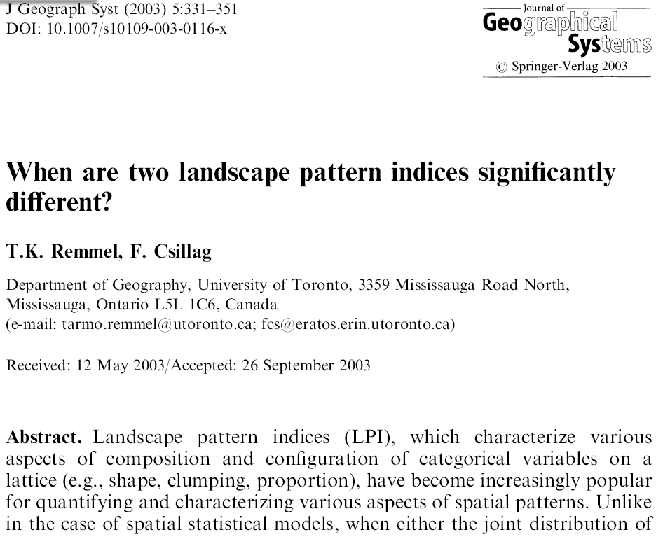
Cautions
Notes:
Landscape pattern indices (LPI), which characterize various aspects of composition and configuration of categorical variables on a lattice (e.g., shape, clumping, proportion), have become increasingly popular for quantifying and characterizing various aspects of spatial patterns. Unlike in the case of spatial statistical models, when either the joint distribution of all values is characterized by a limited number of parameters, or the distribution is known for certain (usually random) cases, the distributions of LPI are not known. Therefore, comparisons of LPI or significance testing of differences among various landscapes and/or studies are uncertain. This paper scrutinizes six widely used LPI, which are computed based on categories mapped onto regular lattices. We designed a simulation using Gauss-Markov random fields to establish the empirical distributions of LPI as functions of landscape composition and configuration. We report the results for stationary binary landscapes. The confidence intervals for LPI are derived based on 1000 simulations of each given combination of parameters, and further details are evaluated for three illustrative cases. We report the distributions of the LPI along with their co-variation. Our results elucidate how proportion of cover classes and spatial autocorrelation simultaneously and significantly affect the outcome of LPI values. These results also highlight the importance and formal linkages between fully specified spatial stochastic models and spatial pattern analysis. We conclude that LPI must be compared with great care because of the drastic effects that both composition and configuration have on individual LPI values. We also stress the importance of knowing the expected range of variation about LPI values so
that statistical comparisons and inferences can be made.

Slide 21
Examples (in IDRISI)
Diversity: H= -∑abs(p•ln(p))
where p = proportion in each class
e.g., 3 x 3 window
1 class, p = 1, ln(p) = 0, H = 0
9 classes, p = 0.11, ln(p) = -2.2, abs(p•ln(p)) = 0.24
∴ 0.24 x 9 = 2.16 = H
Notes:
- originally for species distributions, but can be anything

Slide 22
Fragmentation index:
F = (n-1) / (c-1)
where: n = # different classes in window
c = # cells in window
e.g., 3 x 3 window:
1 class, F = 0;
9 classes, F = 8/8 = 1.0
Many other fragmentation statistics

Slide 23
C-ratio
C = (Ap / Ac)^{½}
Ap = area of polygon
Ac = area of circle with same perimeter as the polygon
∴ C = 1.0 for circle (most compact);
C < 1.0 as perimeter and jaggedness increase
Or: C = P / 3.54 A0.5
Notes:
(many other shape indices, too)

Slide 24

Examples of spatial pattern analysis: GLEL research questions in eastern Ontario

Slide 25
Road ecology
roads follow humans follow roads
focus on impacts of roads on biodiversity (+/-)
kill rates can exceed natural death from predation and disease (Forman et al., 2003)
road kill can adversely affect viability of local populations (Ramp et al. 2005)
Notes:
- one of the specialties of the landscape ecologists that we work with in the lab
- impacts of roads on the environment, especially wildlife
- in THIS study, focussing on impacts on biodiversity/population viability (but they also look at things like behaviour, reproductive success…)

Slide 26
Current and probable past wildlife fatality hotspots
on the Thousand Islands Parkway, Ontario, Canada
E. Eberhardt, S. Mitchell, and L. Fahrig
Notes:
explain affiliations
- ewen - can’t be here, recently defended this as a Master’s thesis, want to publish it, this a good venue to get feed back from the spatial analysis side
- although this work represents a completed Master’s thesis for Ewen, from my perspective, this is hopefully just the beginning, in that the data set is much richer than could be analyzed in the time available, and there are interesting followup opportunities with Parks; so it’s early days in this work, and I’m definitely interested in hearing ideas for moving ahead

Slide 27
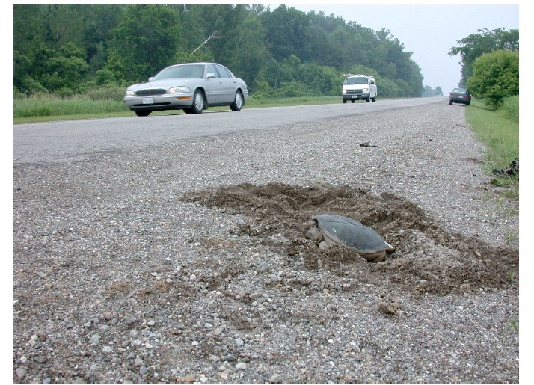
Objectives
overall, improve Park’s ability to enhance and protect environmental integrity
identify current wildlife mortality hotspots on Thousand Islands Parkway
test for effects of traffic volume
relate road kill abundance to hypothesized landscape predictor variables
Notes:
(predictor variables related to habitat requirements)
- originally, thought we would be looking at effects of traffic volume in time - added more for space just in case
- tie to park objectives - environmental integrity

Slide 28
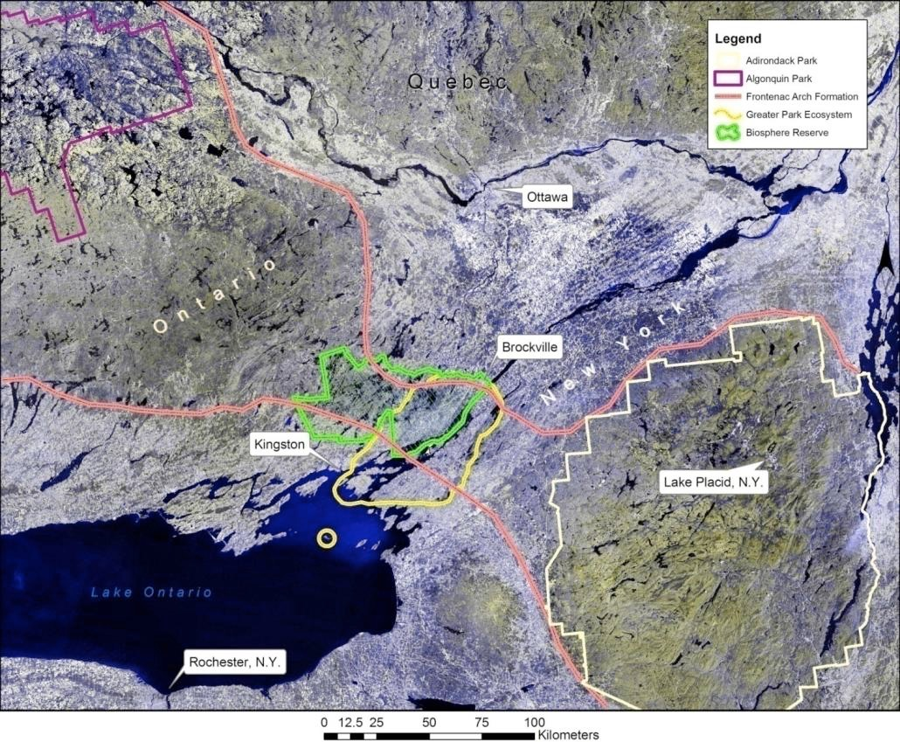
Study Area : Frontenac Axis - AtoA

Slide 29
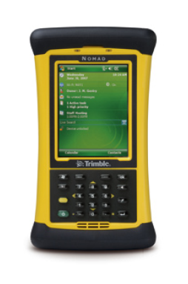
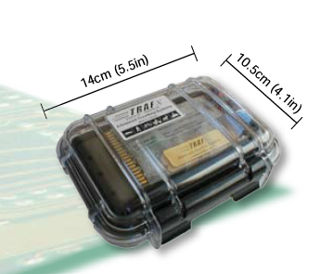
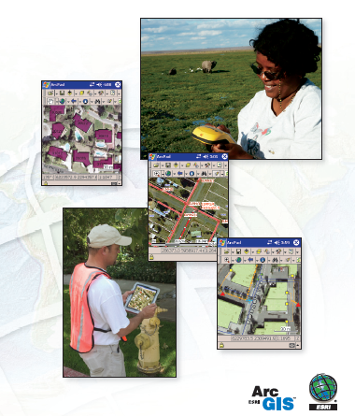
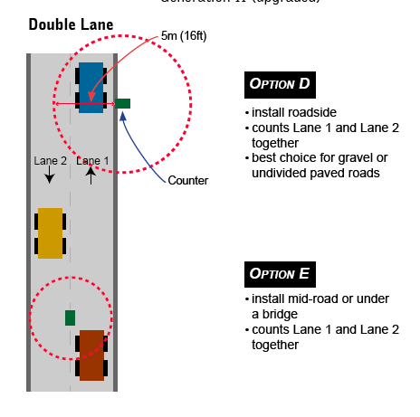

Tools

Slide 30
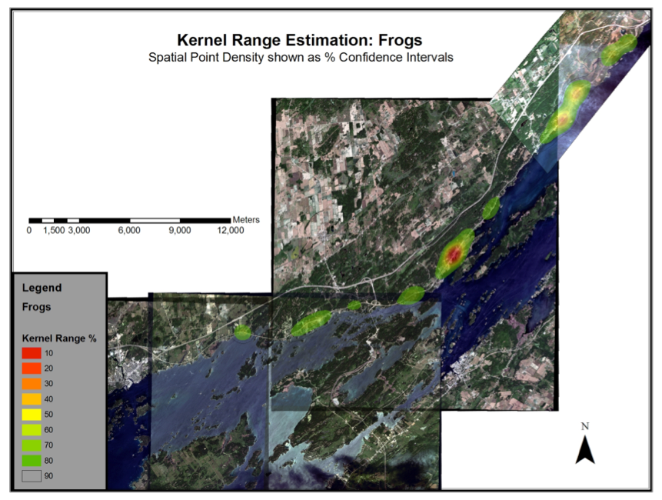
Golf course
Hill Is./
Bridge
Gananoque
Notes:
LABELS ON CLICK!

Slide 31
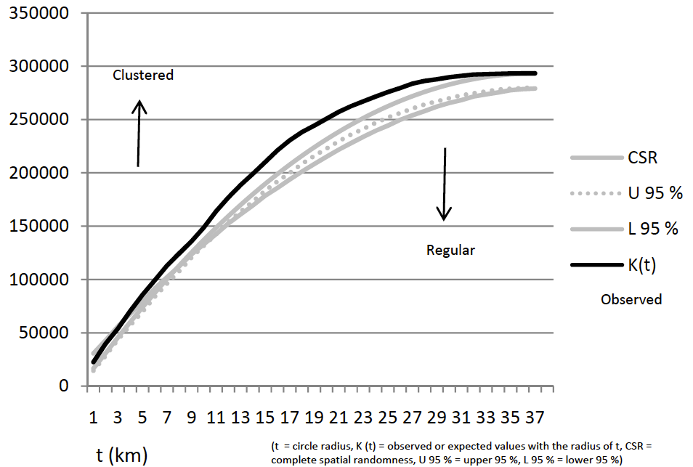
Frogs

Slide 32
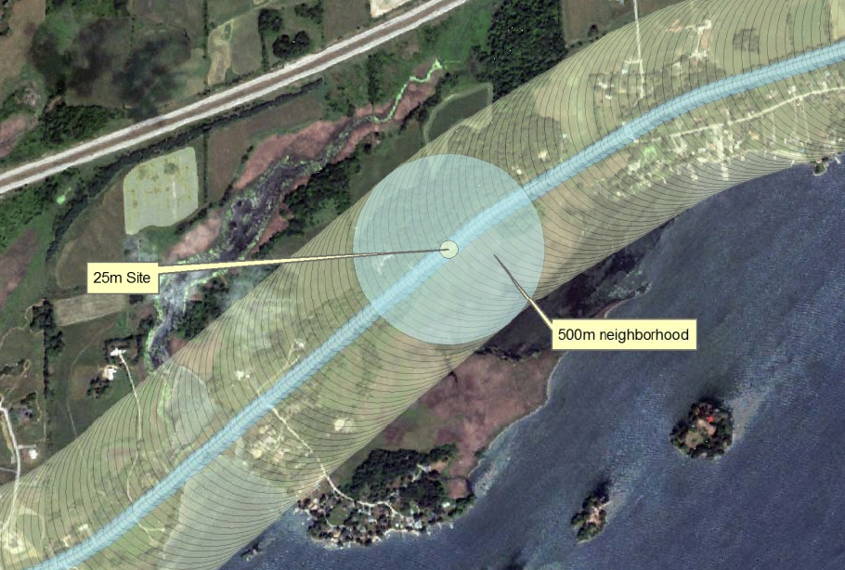
Roving Window Analysis
Notes:
- the response variable is strung along a linear feature, interested in what surrounds it
- define sites and neighbourhoods (other sizes experimented with, but this is what used)
- FROM these potential “sites” and neighbourhoods, select random non-overlapping sets so can do traditional regression with reasonable confidence of independent samples* (radius)

Slide 33
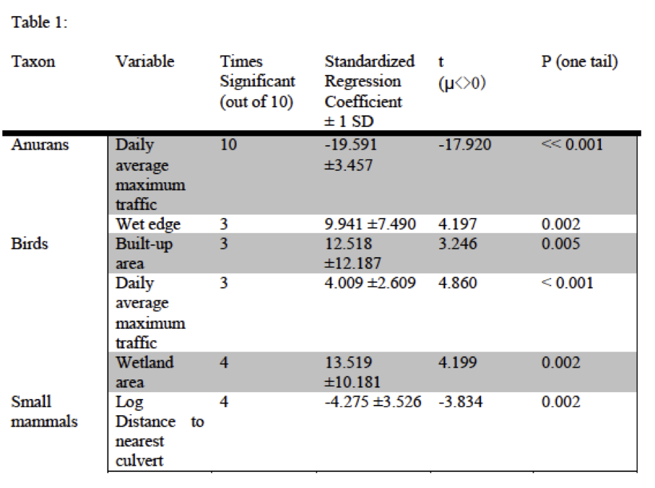

Slide 34
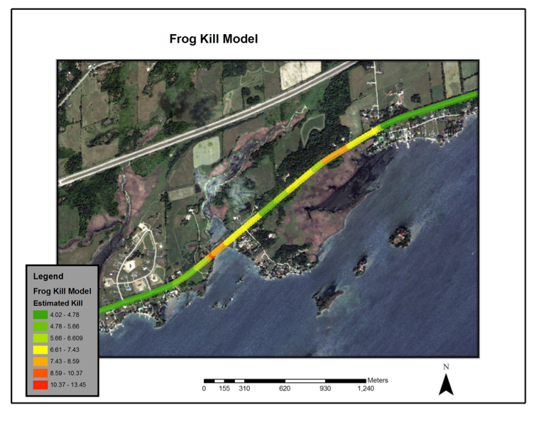
Notes:
… then, aPPLY the resulting model across the whole road, producing this - make clear what the significance was (this particular figure zoomed into part of the western half of the parkway)

Slide 35
Agricultural Production heterogeneity & biodiversity
NSERC Strategic Project 2010-2013
Co-PI with Lenore Fahrig, Doug King, Kathryn Lindsay, Post-docs Jon Pasher, Adam Smith, Jude Girard, Dennis Duro
Actually, “Landscape indicators and agri-environmental policies for biodiversity enhancement on agricultural lands”
Notes:
Example of the COMPLEXITy of properly answering these questions

Slide 36
Part 1: Empirical Study (Objectives 1, 2, 3)
Landscape
Heterogeneity
Measure A
Landscape
Heterogeneity
Measure B
Landscape
Heterogeneity
Measure C
Farming
Practice A
Farming
Practice B
Farming
Practice C
Farmland Biodiversity
Part 2: Simulation Study (Objective 4)
Agri-Environmental
Policy A
Agri-Environmental
Policy B
Agri-Environmental
Policy C
Landscape
Heterogeneity
Measure A
Landscape
Heterogeneity
Measure C

Slide 37
Research Objectives
to determine which measure(s) of landscape heterogeneity are the best indicators (i.e., best predictors) of biodiversity in agricultural landscapes;
heterogeneity of natural area
diversity of production area
pattern of production area

Slide 38
Heterogeneity of Natural Area
biodiversity
?
research is feasible,
results are partly known, policy is feasible?
heterogeneity of natural area
moderate research priority

Slide 39
Diversity of Production Area
?
biodiversity
research is feasible,
results are unknown, policy is feasible
diversity of production area
high research priority

Slide 40
Pattern of Production Area
biodiversity
?
research is feasible,
results are unknown, policy is feasible
pattern of production area
high research priority

Slide 41
Research Objectives
to determine which measure(s) of landscape heterogeneity are the best indicators (i.e., best predictors) of biodiversity in agricultural landscapes;
to determine the appropriate spatial extent(s) at which the indicators best predict biodiversity and therefore the spatial extent(s) at which farmland policies should be implemented;

Slide 42
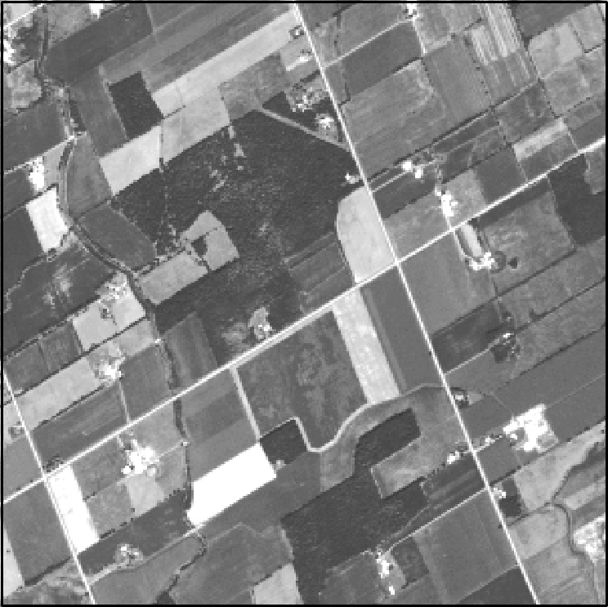
farmland
heterogeneity

Slide 43
Research Objectives
to determine which measure(s) of landscape heterogeneity are the best indicators (i.e., best predictors) of biodiversity in agricultural landscapes;
to determine the appropriate spatial extent(s) at which the indicators best predict biodiversity and therefore the spatial extent(s) at which farmland policies should be implemented;
to determine the relative importance of landscape heterogeneity and farming practices on farmland biodiversity;

Slide 44
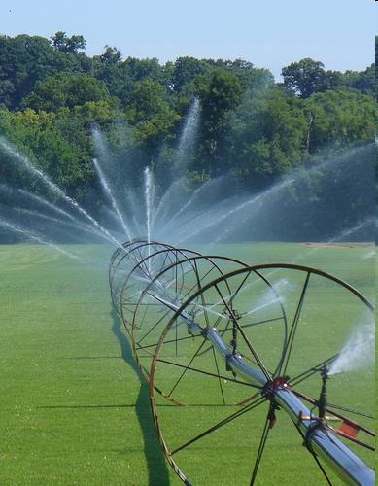
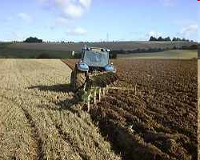
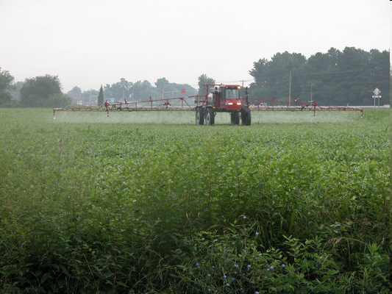
farmland heterogeneity
biodiversity
farming practices

Slide 45
Research Objectives
to determine which measure(s) of landscape heterogeneity are the best indicators (i.e., best predictors) of biodiversity in agricultural landscapes;
to determine the appropriate spatial extent(s) at which the indicators best predict biodiversity and therefore the spatial extent(s) at which farmland policies should be implemented;
to determine the relative importance of landscape heterogeneity and farming practices on farmland biodiversity; &
to determine which agri-environmental policies are most effective at increasing the 'best' farmland biodiversity indicators (as identified in objective 1).

Slide 46
Part 1: Empirical Study (Objectives 1, 2, 3)
Landscape
Heterogeneity
Measure A
Landscape
Heterogeneity
Measure B
Landscape
Heterogeneity
Measure C
Farming
Practice A
Farming
Practice B
Farming
Practice C
Farmland Biodiversity
Part 2: Simulation Study (Objective 4)
Agri-Environmental
Policy A
Agri-Environmental
Policy B
Agri-Environmental
Policy C
Landscape
Heterogeneity
Measure A
Landscape
Heterogeneity
Measure C

Slide 47

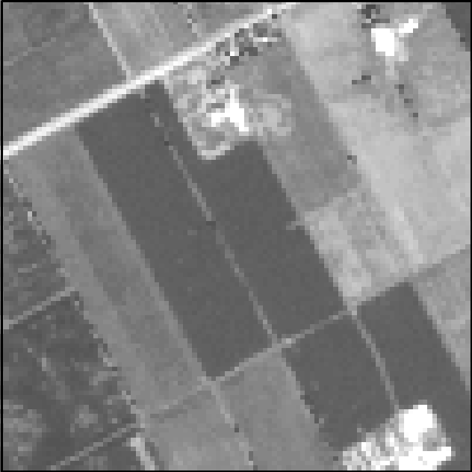
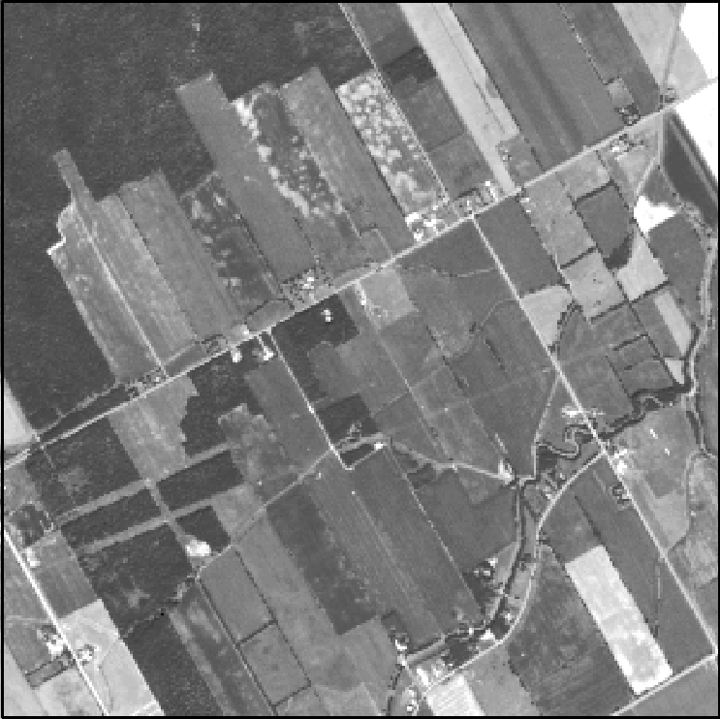

Simulation Study
Policy X
initial landscape
final landscape
simulated time
estimated
initial
EGS
heterogeneity
measures
estimated
final
EGS
heterogeneity
measures
initial biodiversity
final biodiversity
Effectiveness of Policy X = change in biodiversity, EGS
Notes:
(BUT!…)

Slide 48
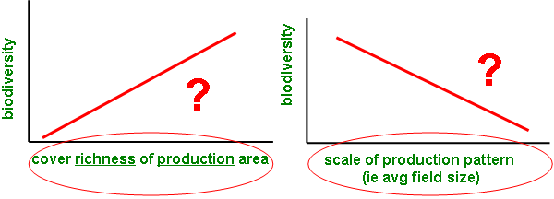
Site Selection
(“Pasher Protocol”)
Amount (% cover)
(Semi-) Natural Area
(NON-Production Agriculture)
Diversity (# of types)
Farmland
Structure
# of cover types
Diversity
Evenness
Pattern scale (ie. Avg patch size)
Production Area
Heterogeneity
Pattern variance (ie. Variance of patch size)
Pattern shape complexity
Pasher et al. (2013)

Slide 49
Selection Criteria
N = 100 (final set)
> N → Temporal changes / permissions / errors / other…
Multiple Extents (i.e. 1x1 km, 2x2 km…)
All criteria satisfied at each extent (!)
> 60% Production Agriculture (row crops, hay, pasture)
Variety of Heterogeneity Levels
Diversity - # of cover types
Distribution of average field sizes

Slide 50
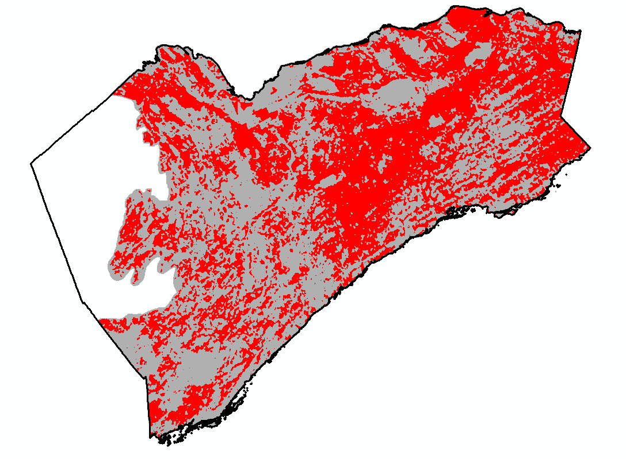
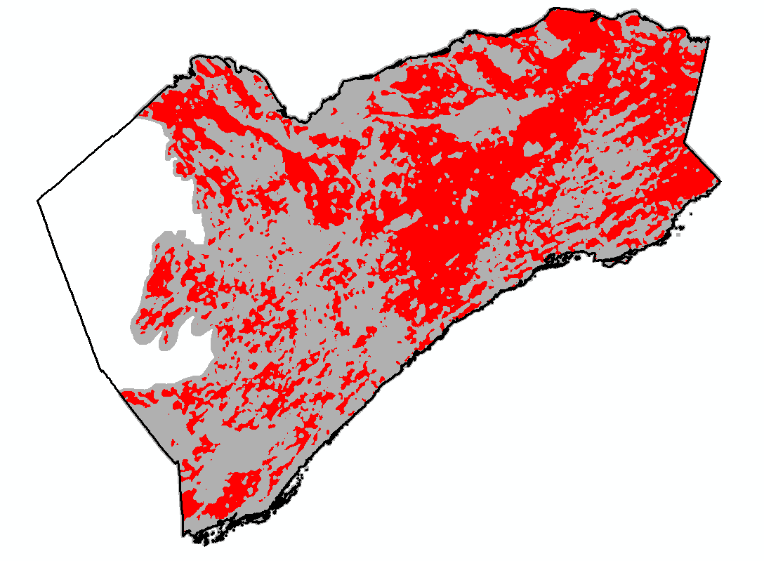

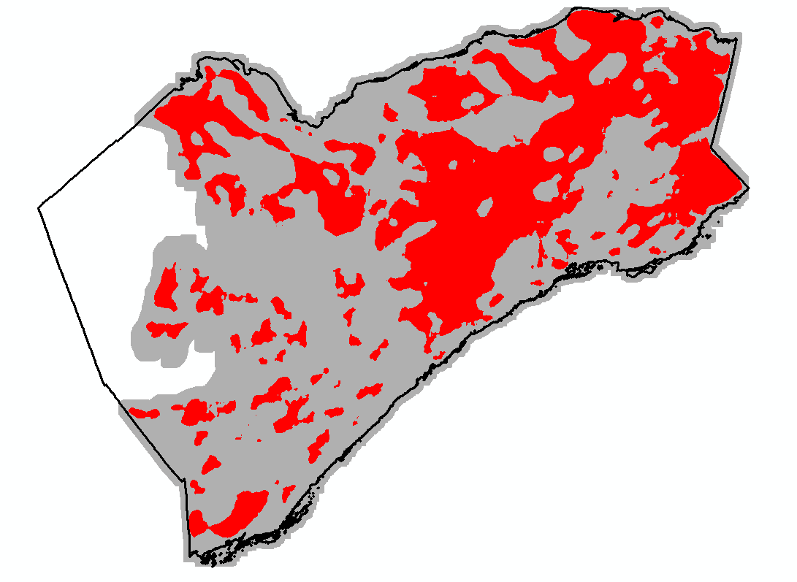
First Step of Site Selection > 60% Active Agriculture
GOAL: > 60 % AG @ 500m & 1km & 2km & 3km
500m x 500m Extent
1km x 1km Extent
2km x 2km Extent
3km x 3km Extent

Slide 51
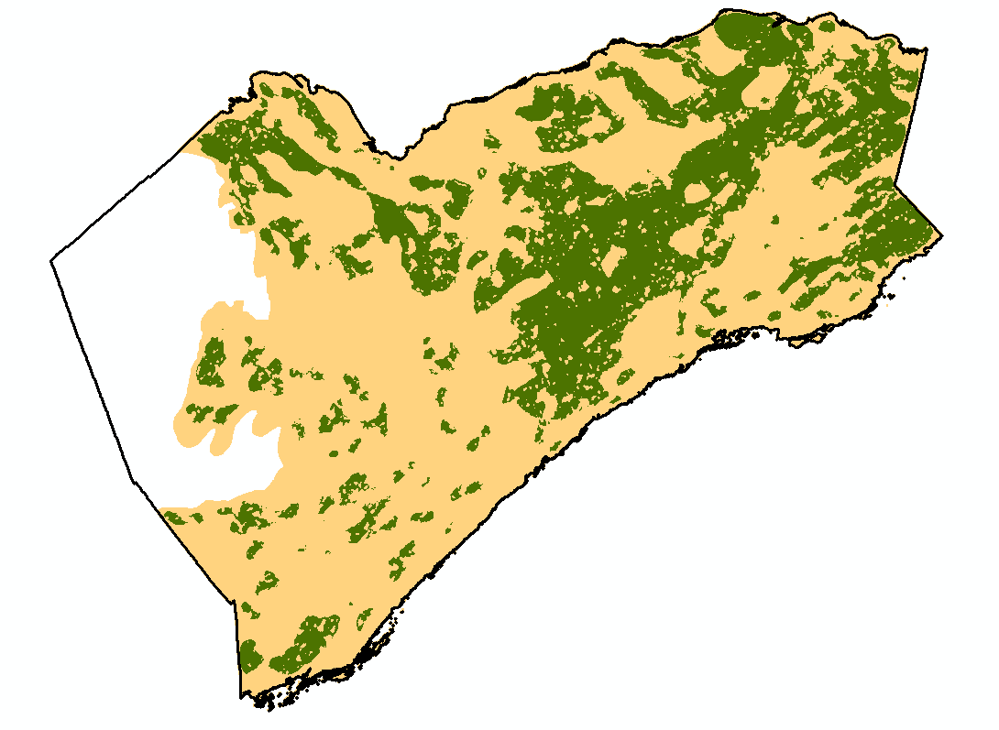
Areas With > 60% Active Agriculture?

Slide 52
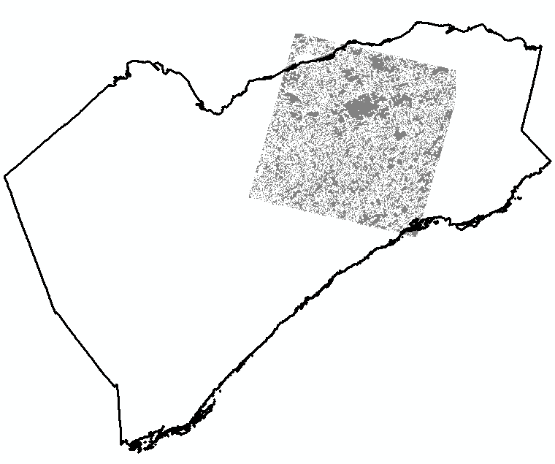
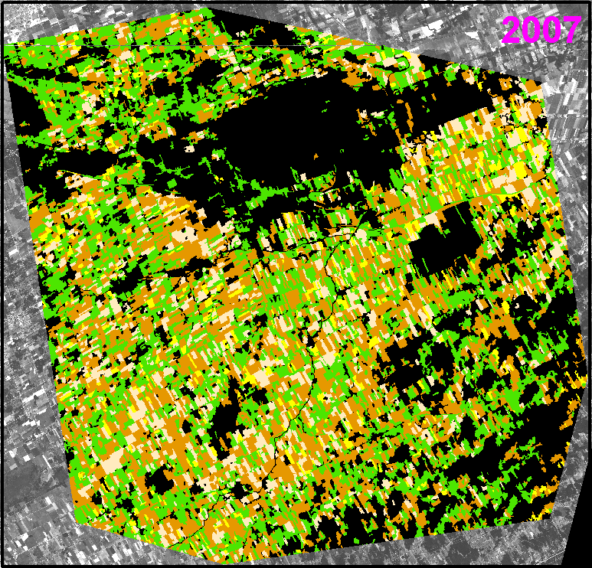
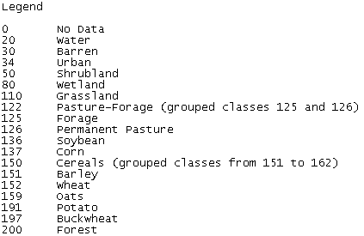

AAFC Crop Classification Data
~ 60 x 60 km SPOT scene centered near Casselman, ON
Crop type classifications for every year 2004-2007
2008 & 2009 yet to be completed
Field trained and validated → good accuracy

Slide 53
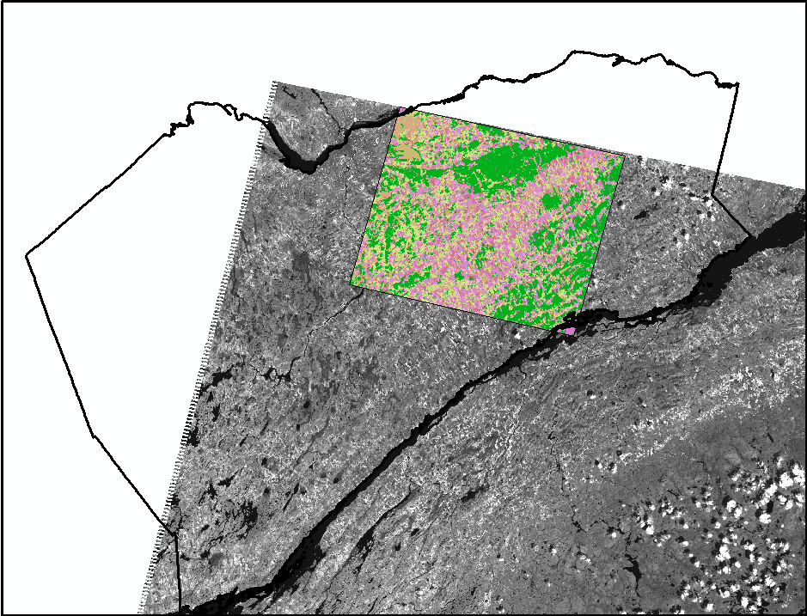
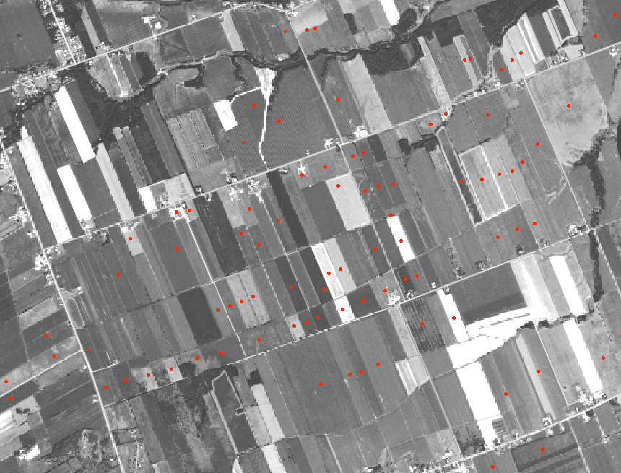
Extrapolate Crop Classification Across Larger Area
AAFC Ground Data – 602 Locations

Slide 54
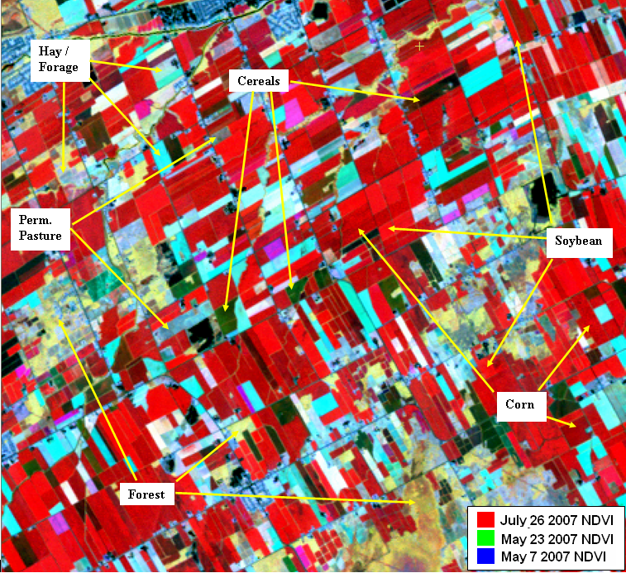
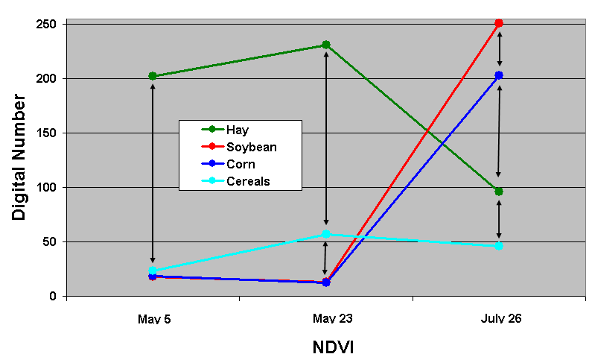
Landsat Multispectral Imagery
3 x Normalized Difference Vegetation Index (NDVI)
Best combination for differentiating between classes of interest

Slide 55
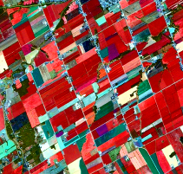
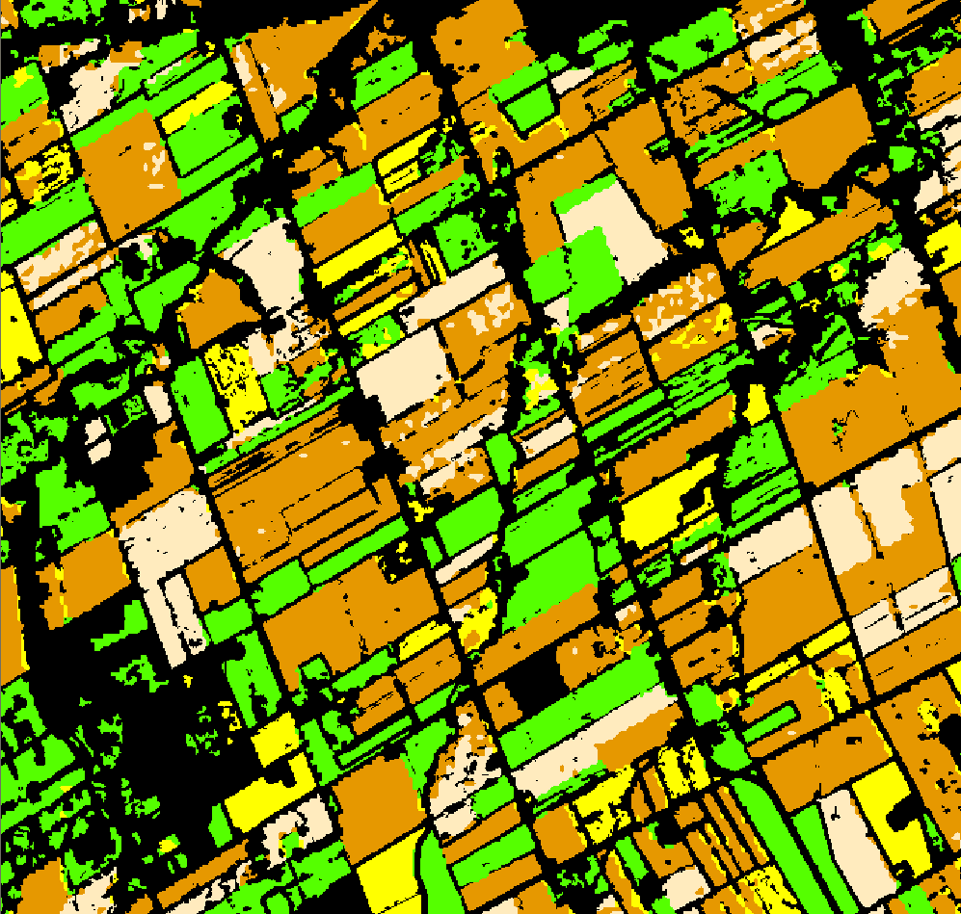
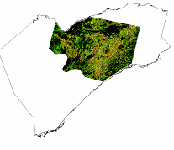
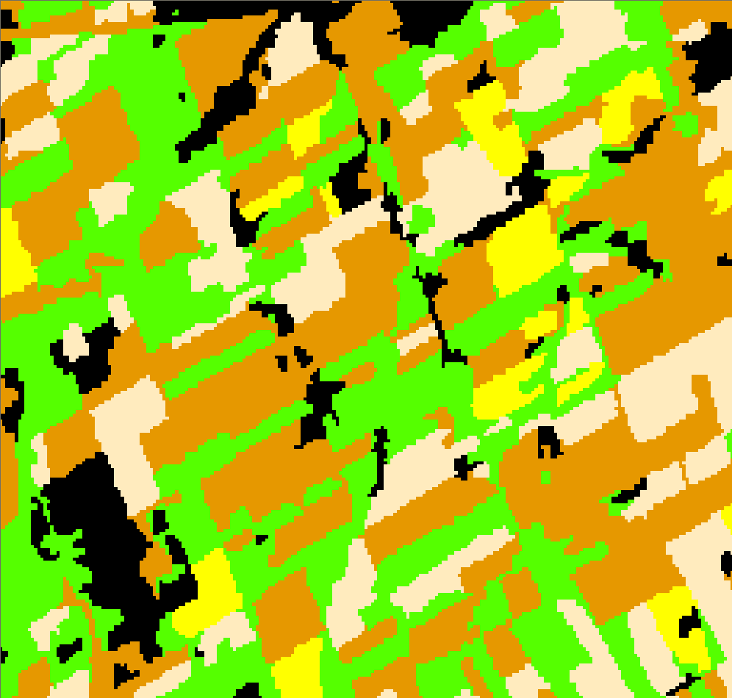
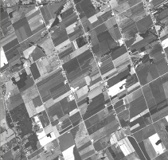
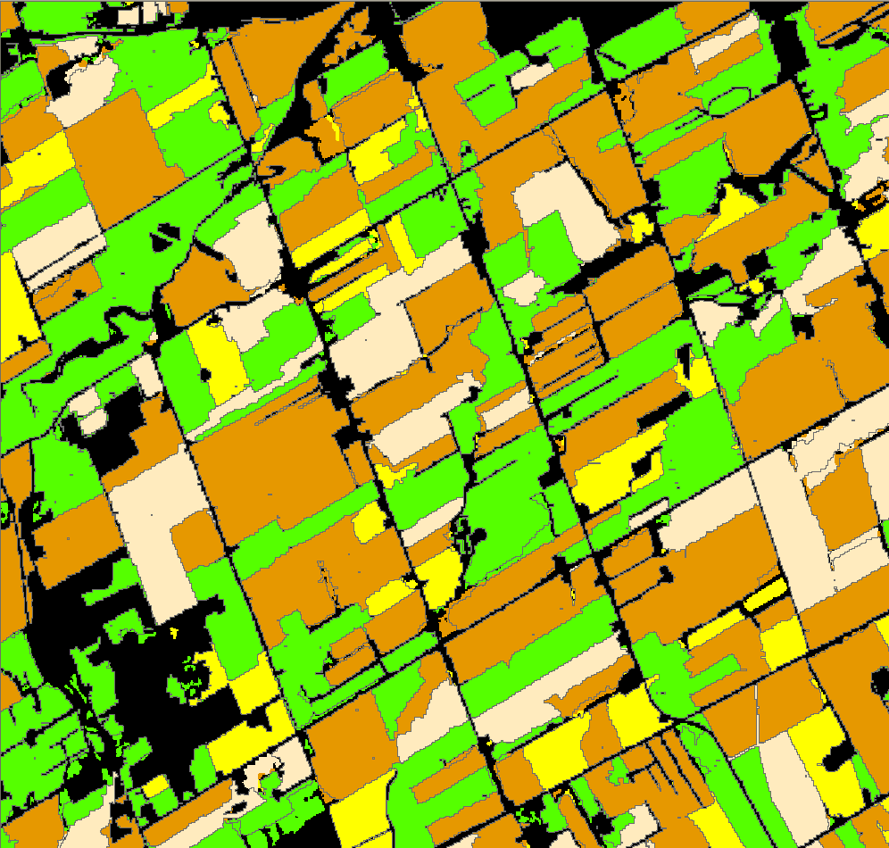
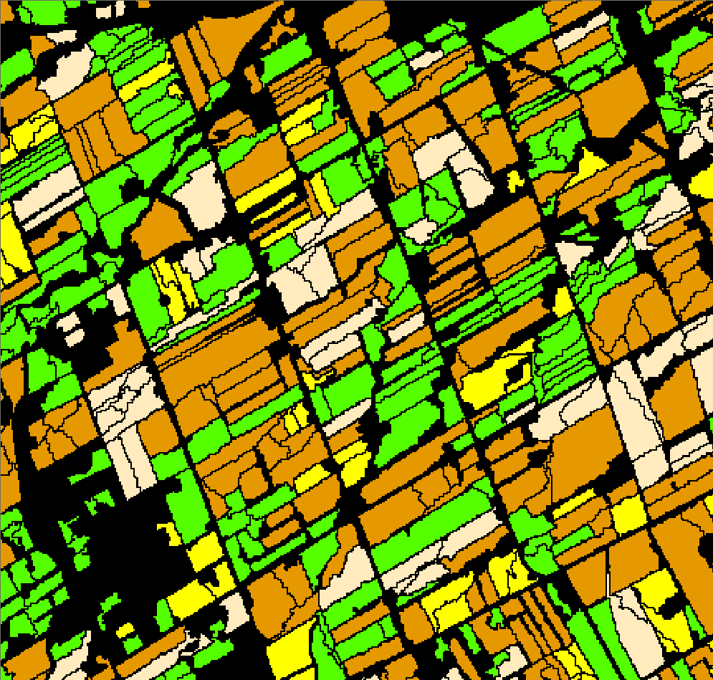
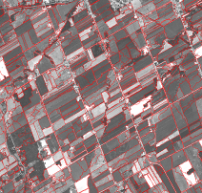
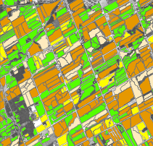
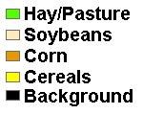
Landsat NDVI Colour Composite
AAFC 2007 Classification
SPOT 10m Panchromatic
Pixel Based Classification
NEW MAP (30m resolution)
Combine Using Majority of Pixels Per Object and Filter Out Small Objects
Introduce 15m internal buffer
(ie ~ a single 30m pixel as buffer)
FRAGSTATS METRICS
Image Segmentation to Objects

Slide 56
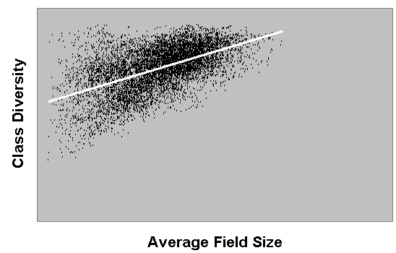
Scatterplot Between Metrics (1km x 1km window)
R = 0.55
R = 0
Include some sites of extreme conditions?

Slide 57


Maximum Extent for Landscapes
Beyond a maximum extent (of interest) landscapes would not have enough variation to provide variability in field sites
Approximately 3km x 3km extent
Insignificant differences once > 3km
Also want landscapes as small as possible since they cannot overlap!

Slide 58

Notes:
93 sites, 46 in 2011, 47 in 2012
100km wide by 70 km
60 miles wide by 40 miles

Slide 59

Notes:
In each landscape, we had four main survey locations, each in an edge between two active fields. At each survey location, we used two 50m transects, one in the edge, and a parallel transect in one of the adjacent fields.

Slide 60













Biodiversity Surveys
Experiments
Land use ground-mapping

Slide 61


Slide 62





Some results
Biodiversity results summary – standardized AIC-weighted mean regression coefficients

Slide 63




Some results

Slide 64



Some results

Slide 65




Some results

Slide 66


Ecosystem services results – biological control

Slide 67

Notes:
… and other spinoffs e.g. selecting the BEST LPI, uncertainty analysis shown in the uncert lecture (1 slide), …

Slide 68
Temporal Stats
Also important to look at patterns in time - many of the same concepts apply
Temporal correlations, autocorrelation
Trend analysis, change detection

Slide 69
Trend Measures
Transition probabilities
from samples over time, determine frequency of transitions from one state to another
repeat for all possible transitions;
each transition proportion of total sample = probability of that transition.

Slide 70
Transition Statistics
identify statistically significant trends towards a given end state over a period of time using a temporal sequence of data.
E.g., Mann-Krendall statistic: …
Notes:
(cont’d next slide)

Slide 71
class differences are determined between all possible forward combinations of dates;
change can be positive (towards given end state) or negative (away from given end state);
a neutral class (no change) can also be used;
changes summed and compared to expected total change for selected statistical significance level and number of sample changes;
if total change score > expected, the trend is statistically significant at the stated level.
Notes:
Note: used to use Doug’s slide on this calculation which had an example for this, but hard to explain - can refer to CC’s work instead

Slide 72





Forest Change Detection and Mapping in Gatineau Park, Québec, 1987 to 2010 using Landsat imagery
Chris J. Czerwinski, Doug J. King and Scott W. Mitchell
Chris Czerwinski
cczerwin@connect.carleton.ca
Notes:
- Talk about prior experience in Gatineau Park as motivation towards a temporal analysis of the park as a whole.

Slide 73


Modeling change using remotely sensed data
Until recently → generally achieved through bi-temporal methods.
Multi-temporal methods may improve the precision of changes detected.
Ground-based data and image calibrations are generally necessary.
Powell et al. 2010

Slide 74



Research Objective
Detect change (vegetation quantity) in Gatineau Park’s forests
Objectives were to determine:
Statistically significant relationships between ground-based estimates of
vegetation quantity and Landsat TM 5 satellite imagery
The location, direction, and magnitude of spectral change
The vegetation communities being impacted and the causal effects of
change (based on objectives 1 and 2).
June 9, 2010 – Champlain Lookout
Notes:
The goal of this research...

Slide 75



Image calibration of 13 near-anniversary images (1987 to 2010)...
Plot-level trajectories improve → R² increases, standard error (SE) decreases

Slide 76

Mann-Kendall trend test
Tests for a slope of zero in a variable ordered in time
Pixel-level analysis (magnitude and significance of a monotonic trajectory)
Probability = 5/6
Magnitude = mean slope of all iterations
Vegetation Quantity
Time
Notes:
Beyond image differencing, the Mann-Kendall was used to detect subtle trends within the forests of GP.

Slide 77




Mapping Abrupt Change

Slide 78

Mann-Kendall change results (1987 to 2007)
Results vary depending on the input data, but overall the same regions are targeted as changing

